Slide 1
Unit 19 Ethical and Legal Aspect of Nursing
Anju Poudel

Slide 2
Values, Morals, & Ethics
Values: are freely chosen, enduring beliefs or attitudes about the worth of a person, object, idea, or action (e.g. freedom, family, honesty, hard work)
Values frequently derive from a person’s cultural, ethnic, and religious background; from societal traditions; and from the values held by peer group and family
Values form a basic for Behaviour “purposive Behaviour”; The purposive behavior is based on a person’s decisions/choices, and these decisions/choices are based on the person’s underlying values.

Slide 3
What values you hold about life, health, illness, and death.
How do your values influence the nursing care you provide?
We should explore our own values and beliefs regarding such situations as the following:
An individual’s right to make decisions for self when conflicting with medical advice
Abortion
End-of –life issues

Slide 4
Morals: Derived from the Latin “mores”, means custom or habit.
Morals: are based on religious beliefs and social influence and group norms
Personally held belief, opinion and attitudes that guide our actions.

Slide 5
Ethics: refers to the rules that a social system provides us with.
These are the codes of how to act in a workplace, in a public place, in a church, or anywhere else where other people are present. It’s necessary to act according to ethical principles even if they don’t agree with your own feelings.

Slide 6
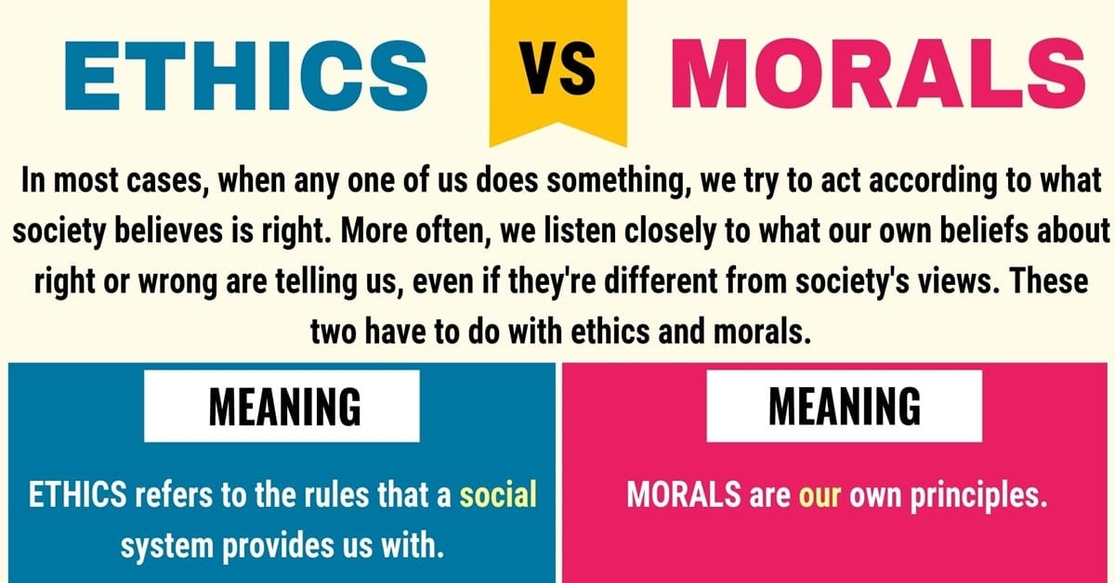

Slide 7
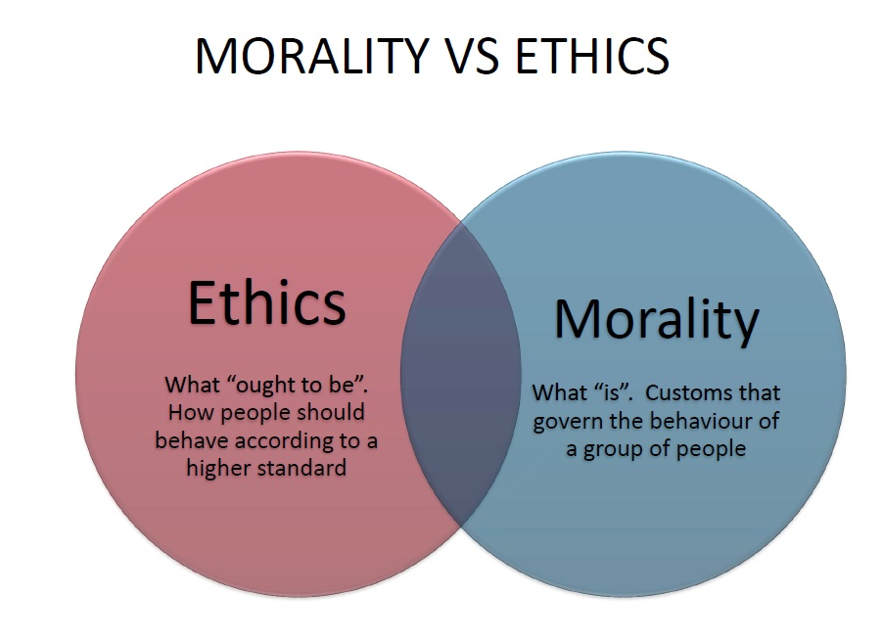

Slide 8


Slide 9
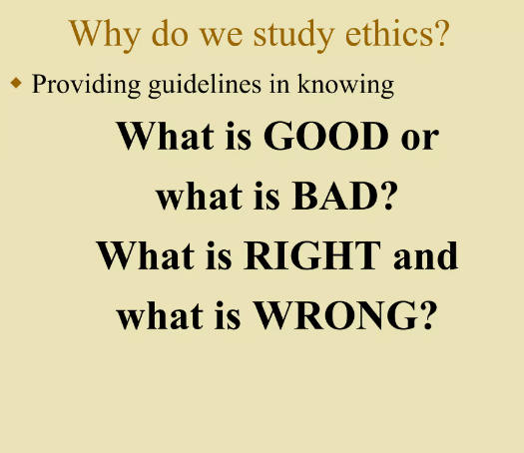

Slide 10
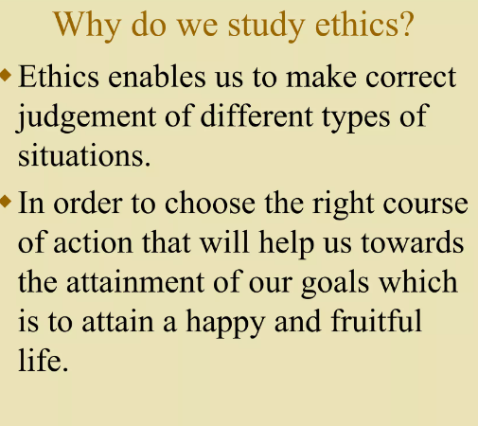

Slide 11
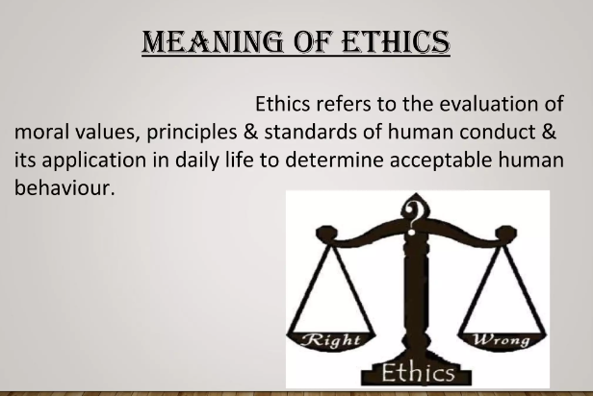

Slide 12
Ethics
Ethics is the study of good conduct, character and motives. It is concerned with determining what is good or valuable for all people.
Ethics is the branch of philosophy that concerns the distinction of right from wrong on the basis of the knowledge, not just on the basis of opinion.
Ethics are declarations of what is right or wrong and what ought to be.
Ethics is defined as the standards or principles of moral judgment or actions.

Slide 13
Nursing Ethics
Nursing ethics refers to the application of ethical principles in nursing practice.
Nursing ethics is an area of ethics which concerns the nursing profession.

Slide 14
Cont..
System of principles concerning the action of the nurse in relationships with patients, families, other health care providers, policy makers, and society
Nursing ethics is a set of shared values or principles that govern the way nurses interact with patients, a patient's family, and even other doctors and nurses.

Slide 15
Why Nursing Ethics Is Important?
Having a code of ethics helps guide nurses through tricky situations and serves as a common reference point for everyone on the health care team.
But the primary goal of nursing ethics is to protect patients.
Veering(shifting) from the code of ethics can lead to a breakdown in team communication and physical consequences for a patient.

Slide 16


Slide 17
The ICN Code of Ethics for Nurses
An international code of ethics for nurses was first adopted by the International Council of Nurses (ICN) in 1953.
It has been revised and reaffirmed at various times since, most recently with this review and revision completed in 2021.

Slide 18
PURPOSE OF THE CODE
The ICN Code of Ethics for Nurses is a statement of the ethical values, responsibilities and professional accountabilities of nurses and nursing students that defines and guides ethical nursing practice within the different roles nurses assume.

Slide 19
The ICN Code of Ethics for Nurses provides ethical guidance in relation to nurses’ roles, duties, responsibilities, behaviours, professional judgement and relationships with patients, other people who are receiving nursing care or services, co-workers and allied professionals.

Slide 20
The values and obligations expressed in this Code apply to nurses in all settings, roles and domains of practice.

Slide 21
Preamble
Nurses have consistently recognized four fundamental nursing responsibilities: to promote health, to prevent illness, to restore health, and to alleviate suffering and promote a dignified death. The need for nursing is universal.

Slide 22
THE ICN CODE
The ICN Code of Ethics for Nurses has four principal elements that provide a framework for ethical conduct:
nurses and patients or other people requiring care or services
nurses and practice
nurses and the profession
nurses and global health.

Slide 23
1. Nurses and patients or other people requiring care or services
Nurses’ primary professional responsibility is to people requiring nursing care and services now or in the future, whether individuals, families, communities or populations
Nurses promote an environment in which the human rights, values, customs, religious and spiritual beliefs of the individual, families and communities are acknowledged and respected by everyone.

Slide 24
Nurses ensure that the individual and family receive understandable, accurate, sufficient and timely information in a manner appropriate to the patient’s culture, linguistic, cognitive and physical needs, and psychological state on which to base consent for care and related treatment.

Slide 25
Nurses hold in confidence personal information and respect the privacy, confidentiality and interests of patients in the lawful collection, use, access, transmission, storage and disclosure of personal information.
Nurses advocate for equity and social justice in resource allocation, access to health care and other social and economic services.

Slide 26
Nurses demonstrate professional values such as respect, justice, responsiveness, caring, compassion, empathy, trustworthiness and integrity. They support and respect the dignity and universal rights of all people, including patients, colleagues and families

Slide 27
2. Nurses and Practice
Nurses carry personal responsibility and accountability for ethical nursing practice, and for maintaining competence by engaging in continuous professional development and lifelong learning.
Nurses maintain fitness to practice so as not to compromise their ability to provide quality, safe care.

Slide 28
Nurses practice within the limits of their individual competence and regulated or authorized scope of practice and use professional judgement when accepting and delegating responsibility.
Nurses take appropriate actions to safeguard individuals, families, communities and populations when their health is endangered by a co-worker, any other person, policy, practice or misuse of technology.

Slide 29
Nurses are active participants in the promotion of patient safety. They promote ethical conduct when errors or near misses occur, speak up when patient safety is threatened, advocate for transparency, and work with others to reduce the potential of errors.

Slide 30
3. Nurses and the profession
Nurses assume the major leadership role in determining and implementing evidence-informed, acceptable standards of clinical nursing practice, management, research and education.
Nurses and nursing scholars are active in expanding research-based, current professional knowledge that supports evidence-informed practice.
Nurses are active in developing and sustaining a core of professional values.

Slide 31
Nurses, through their professional organizations, participate in creating a positive and constructive practice environment where practice encompasses clinical care, education, research, management and leadership.
Nurses prepare for and respond to emergencies, disasters, conflicts, epidemics, pandemics, social crises and conditions of scarce resources. The safety of those who receive care and services is a responsibility shared by individual nurses and the leaders of health systems and organisations.

Slide 32
4. Nurses and Global Health
Nurses value health care as a human right, affirming the right to universal access to health care for all.
Nurses uphold the dignity, freedom and worth of all human beings and oppose all forms of exploitation, such as human trafficking and child labor.
Nurses lead or contribute to sound health policy development.

Slide 33
Nurses collaborate across countries to develop and maintain global health and to ensure policies and principles for this.

Slide 34
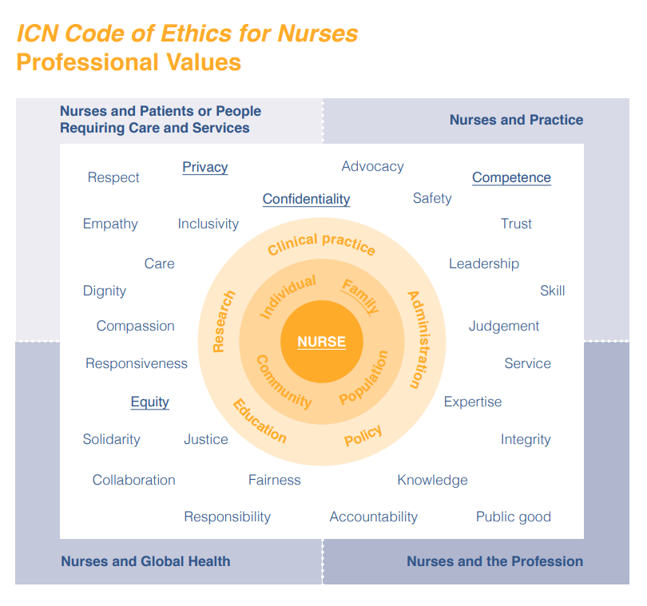

Slide 35
Ethical Principle
Are statements about broad, general philosophic concepts such as autonomy and justice.
They provide the foundation for moral values, which are specific prescriptions for actions (e.g. “people should not lie” (rule) is based on the moral principle of respect of autonomy for people.

Slide 36
Autonomy
Involves the right of self-determination, right to full disclosure, independence, and freedom.
It refers to the right to make one’s own decisions
Respect for autonomy means that nurses recognize the individual’s uniqueness, the right to be what that person is, and the right to choose personal goals
Nurses who follow the principle of autonomy respect a client's right to make decisions even when those choices seem not to be in the client’s best interest

Slide 37
Respect for people also means treating others with consideration
In the clinical setting, this principle is violated when a nurse disregards client's subjective accounts of their symptoms (e.g. pain)
Patients should give informed consent before tests and procedures are carried out

Slide 38
Beneficence
means “doing good”
Nurses should implement actions that benefit clients and their support persons.
ensuring that the patient's best interest is considered, regardless of the nurse's personal opinion.
Examples of beneficence in nursing include providing comfort to a dying patient or assisting with tasks a patient cannot perform independently.

Slide 39
Nonmaleficence
Obligation to do no harm.
The avoidance or minimization of harm.
Nonmaleficence in nursing requires the provision of safe, effective, high-quality care.
Examples of nonmaleficence in nursing include holding a medication due to adverse reactions or taking steps to ensure a safe work environment.

Slide 40
Justice
Fairness or an equal distribution of benefits.
Determining the order in which clients should be cared for.
Justice in nursing relates to impartiality regarding a patient's age, ethnicity, economic status, religion, or sexual orientation.

Slide 41
Veracity
Obligation to be honest and tell the truth.
being completely open and honest with patients, even if the truth causes distress.
Not to lie or deceive others.
A client always has the right to know about his diagnosis and care options.
While being completely truthful can be daunting, especially in certain patient care circumstances, veracity in nursing is important for establishing trust and strengthening the nurse-patient relationship.

Slide 42
Fidelity
Keeping Promises
Being faithful to agreements and responsibilities one has undertaken.
The nurse must be faithful to the promises they made as professionals to provide competent, quality care to their patients.
Without fidelity, trusting relationships cannot be formed.

Slide 43
Ethical Dilemma
A conflict between moral imperatives, i.e., what is right thing to do?
Situation or problem that calls for a person to choose between two alternatives.
Ethical dilemma occurs when there is a conflict between two or more ethical principles.
Having to choose an action that promotes one principle or value but violates another one.

Slide 44
EXAMPLES

Slide 45
EXAMPLES
What is medically right vs. patient preference
What is preferred by patient vs. proxy decision maker
rights of minor vs. legal guardians
What is best for patient vs. what is best for society

Slide 46
Pro-Life vs. Pro-Choice
Discussion

Slide 47
2. Protecting the Right to Privacy/Confidentiality
Discussion

Slide 48
Ram is a sixteen-year-old who was diagnosed with a sexually transmitted infection (STI). Although the doctor examined Ram and told him about his diagnosis privately, Ram's mother is in the waiting room and wants to know what the doctor said. Ram told the doctor and nurse that he does not want anyone to know about the STI, including his mother.

Slide 49
3. Empirical Knowledge vs. Religious Beliefs
Discussion

Slide 50
4. Euthanasia
Discussion

Slide 51
5. Role conflict
Discussion

Slide 52
6. Care of client living with HIV/AIDs, Hepatitis
Discussion

Slide 53
7. Nurse patient ratio
Discussion

Slide 54
Reason of Ethical Dilemmas
Patients or their loved ones must make life or death decisions
The patient refuses treatment.
Nursing assignments may contradict cultural or religious beliefs.
Nursing peers demonstrate incompetence.
Inadequate staffing

Slide 55
Ethical Responsibilities of Nurses
Nurses often face and deal with ethical issues and dilemmas.
Nurses must understand their values and morals to be able to deal adequately with the ethical issues.
They are expected to adhere to a code of ethics during daily duties
ICN code of ethics acts as a guide to help them deal with possible challenges associated with their line of work.
A nurse should learn to apply ethical principles of autonomy, beneficience, non-maleficience, varacity, fidelity, justice and respect for others.

Slide 56
Conceptualize the ethical terminologies
When nurses conceptualize the ethical principles she should understand his/her scope of practice, responsibility and limitations.
Give respect by maintaining dignity and autonomy of the client
Show strong commitment with patients, professionalism and boundaries.
Protect client by maintaining privacy, safety and standards.
Maximize the client’s wellbeing and protect other client’s wellbeing.
Working well with co-workers.

Slide 57
Legal Concepts in Nursing

Slide 58
Laws
Formal codified norms of which everyone is expected to be aware. Violation of laws carry specific sanctions such as fines or imprisonment.

Slide 59
Types of Law
Statutory Law
Created by elected legislators
Can be either criminal or civil
Example: Nurse Practice Acts (NPA), Emergency Medical Treatment and Active Labor Act (EMTALA)
Common Law
Created by judicial bodies as a result of legal cases
Examples: “Informed consent,” “abortion rights,” client’s right to refuse treatment

Slide 60
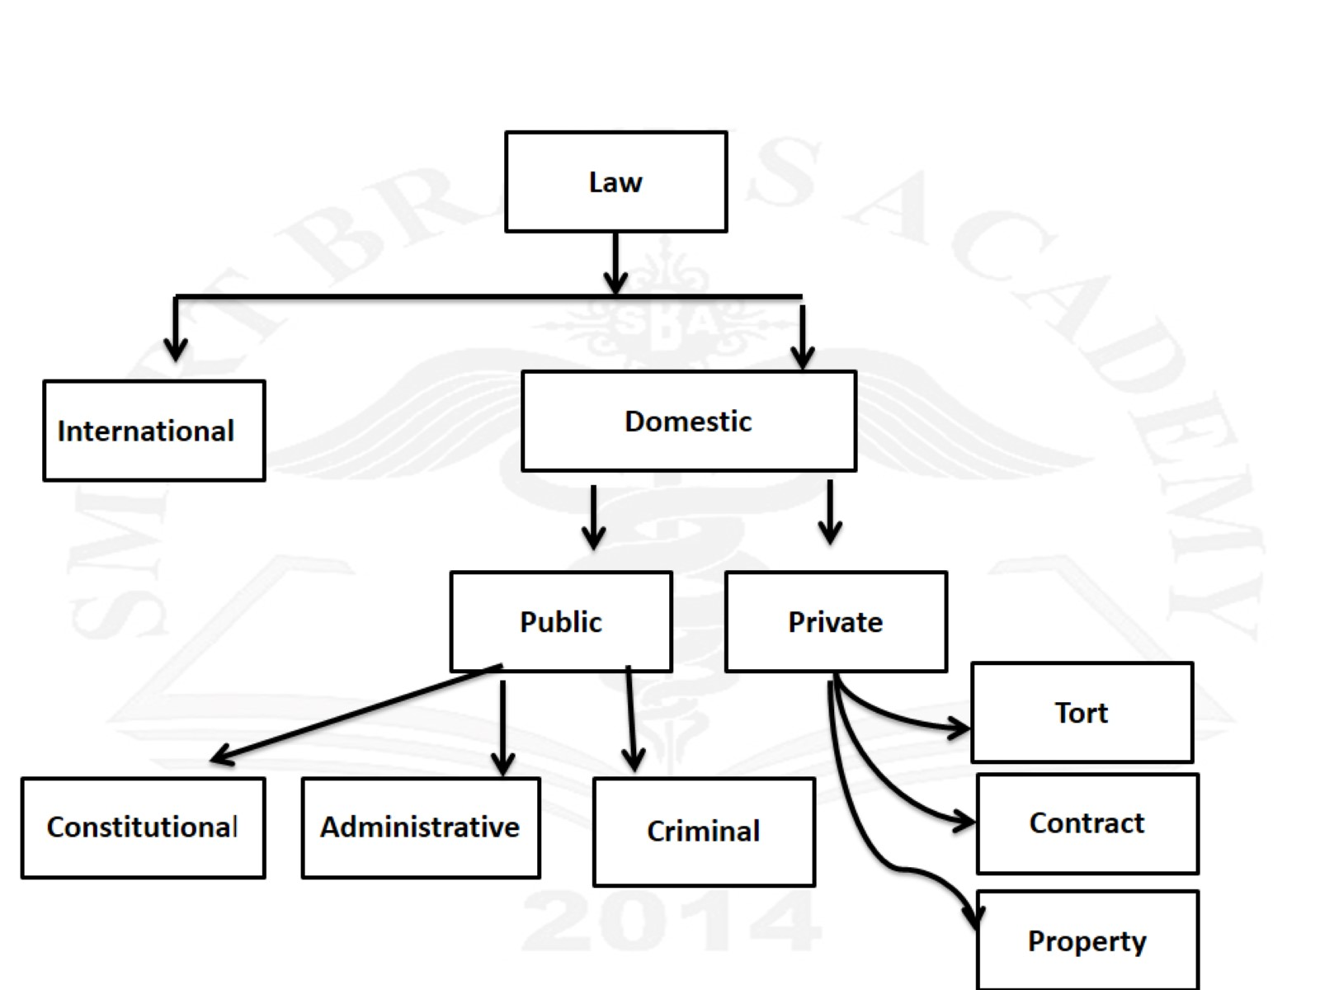

Slide 61
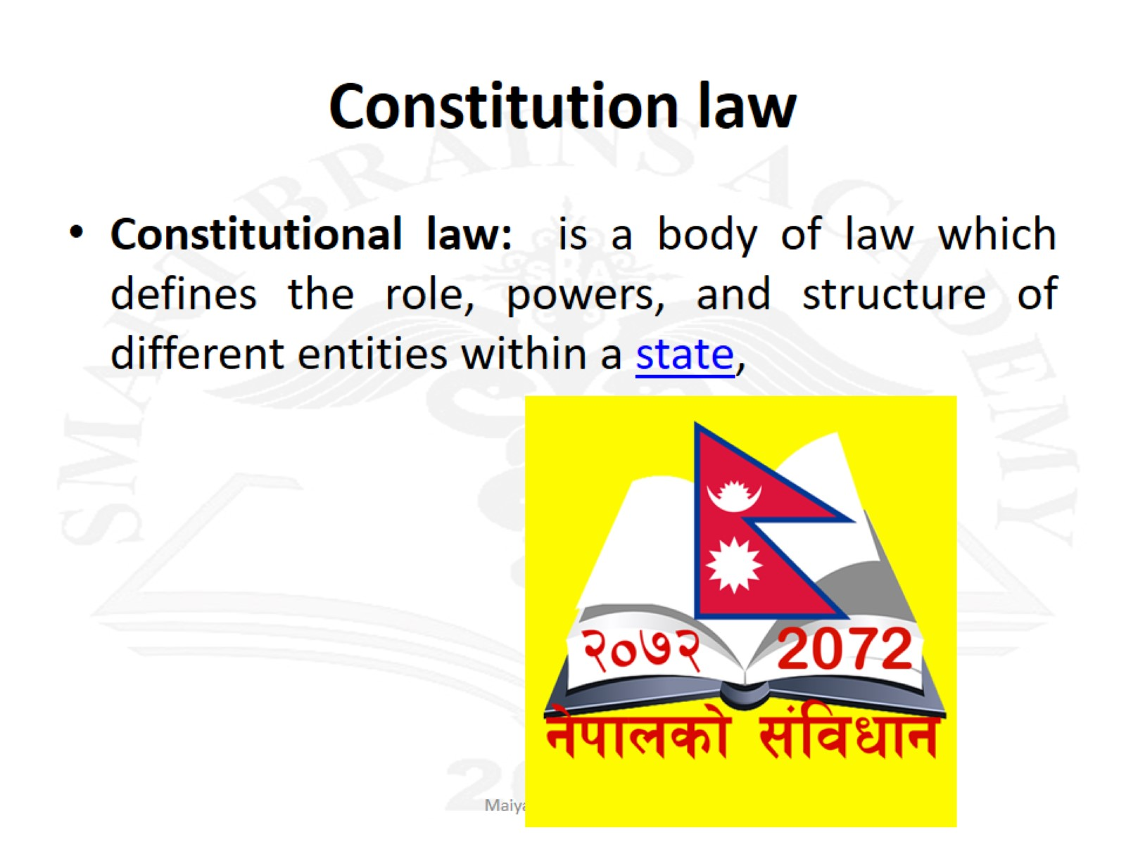
Constitution law

Slide 62
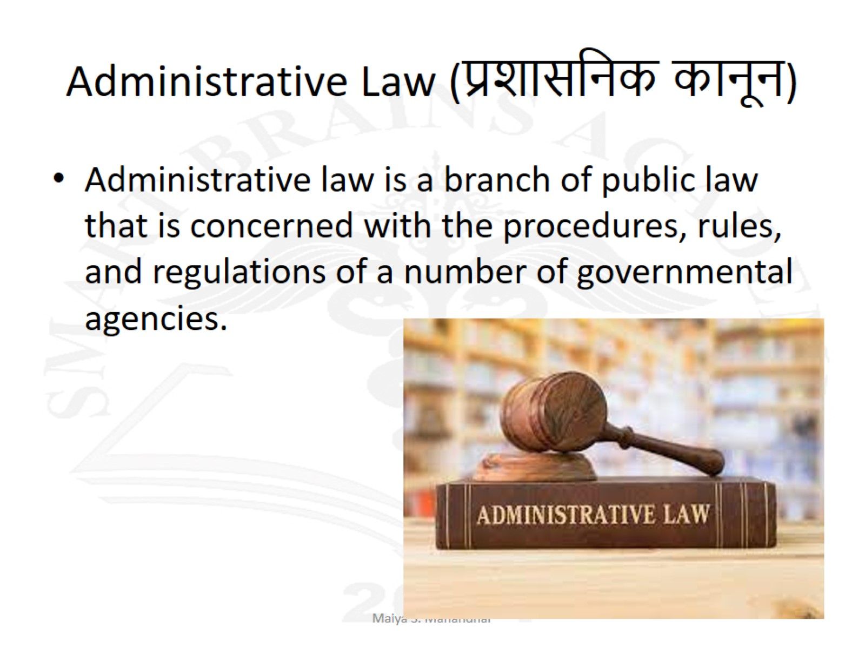
Administrative Law (प्रशासनिक कानून)

Slide 63
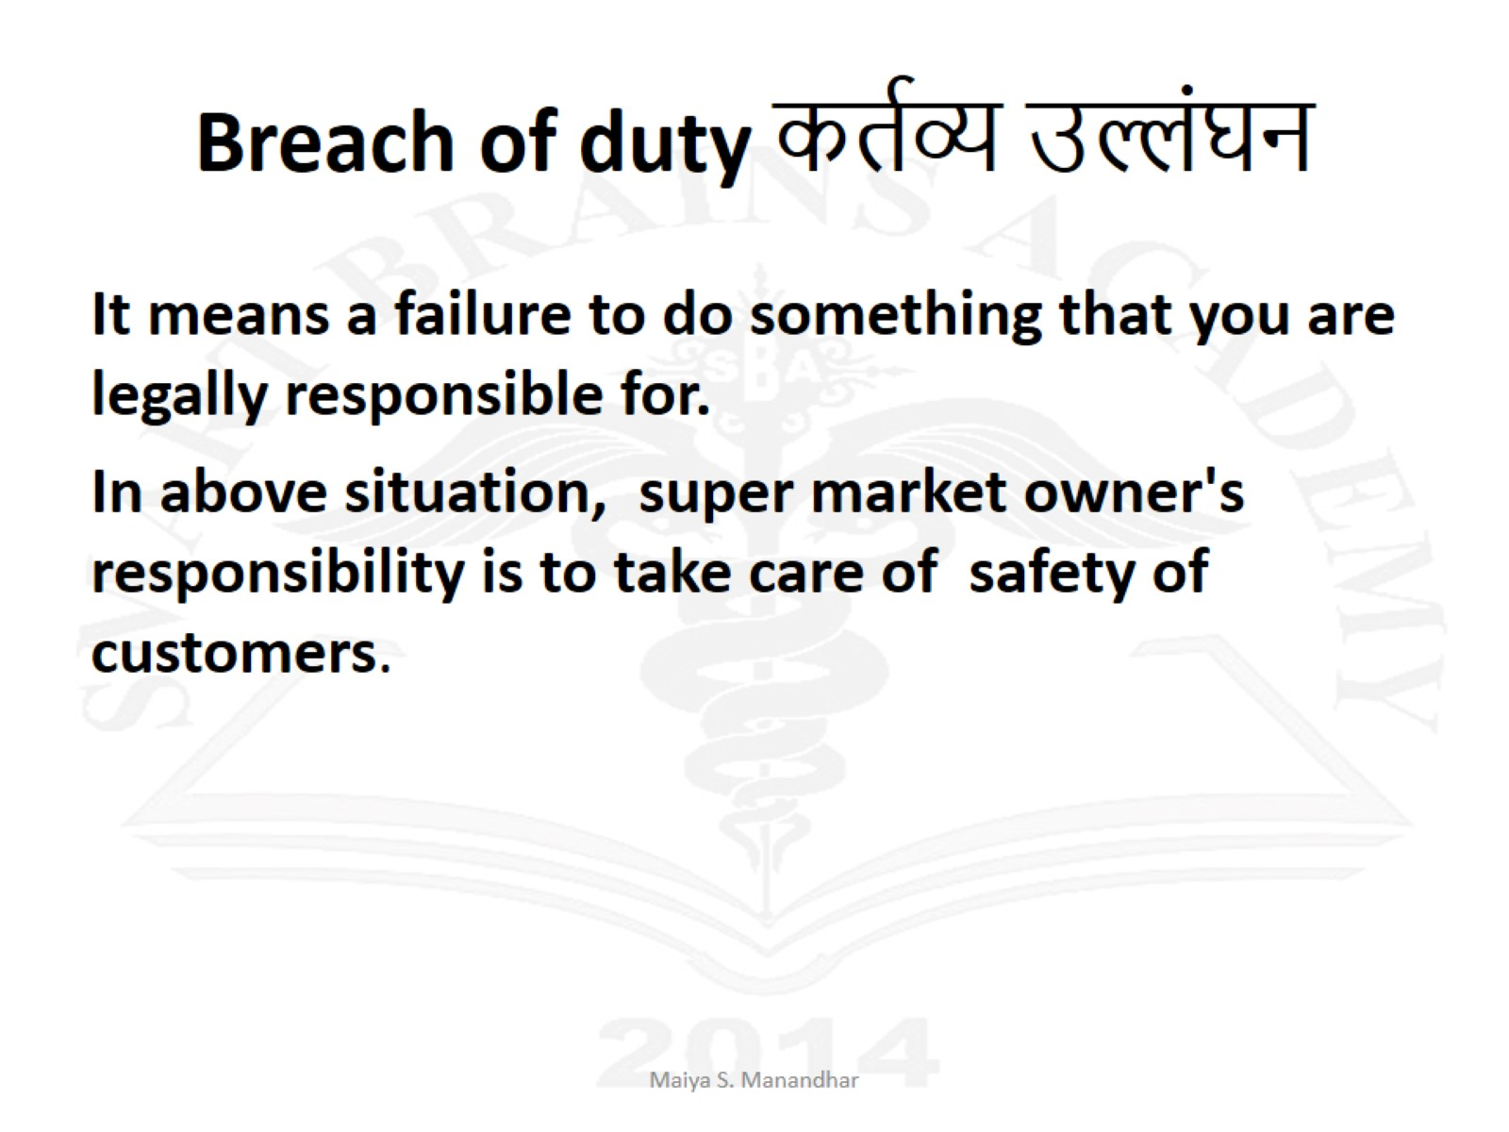
Crime – is an act that is a violation of duty or breach of law, punishable by the state by fine or imprisonment.

Slide 64
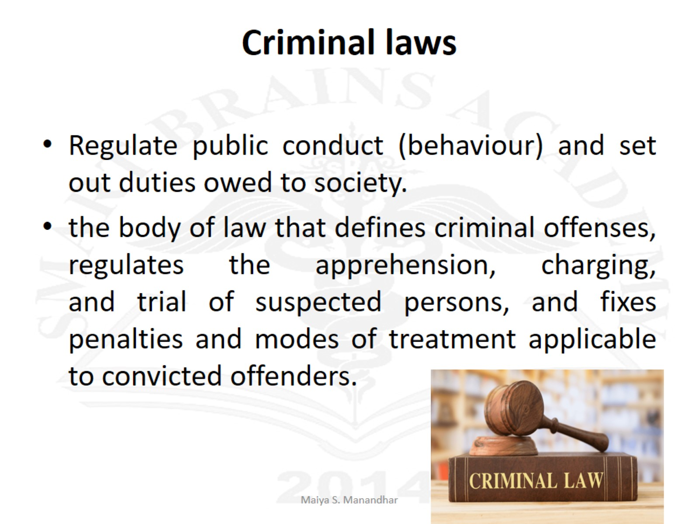
Criminal laws

Slide 65
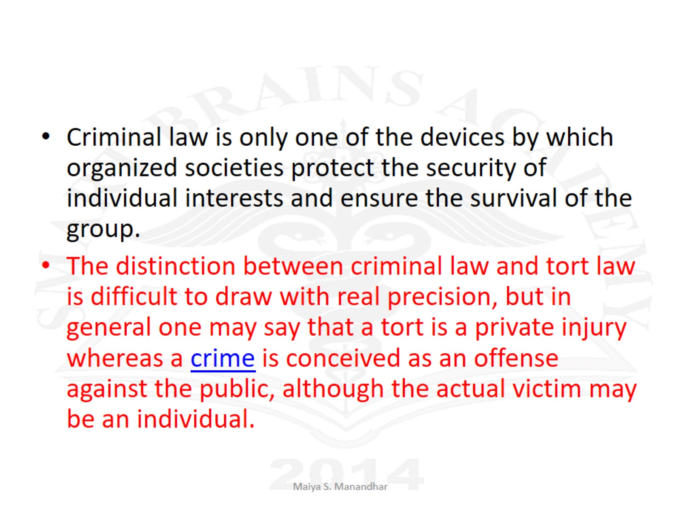

Slide 66
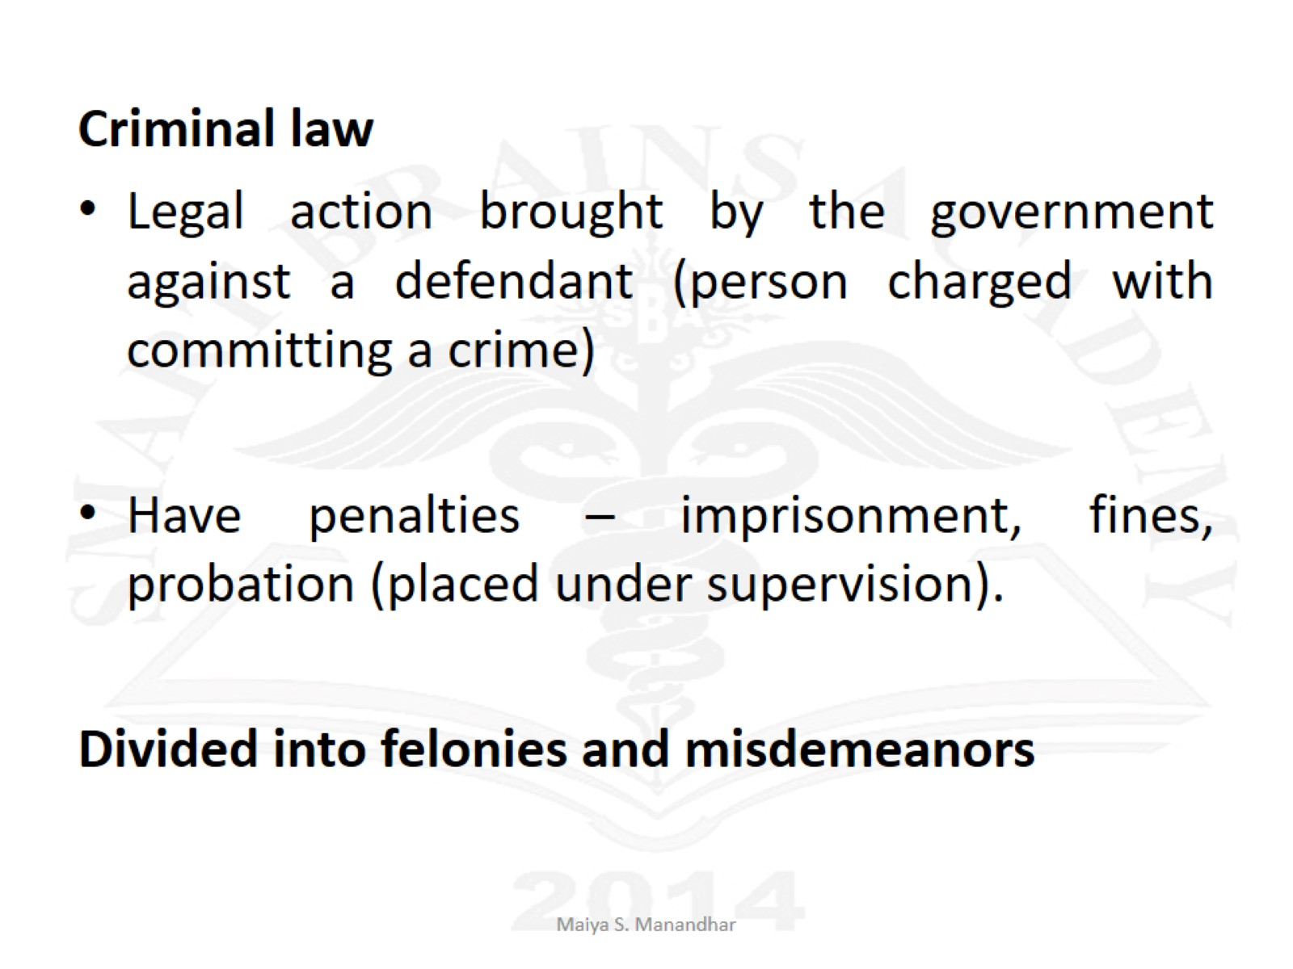

Slide 67
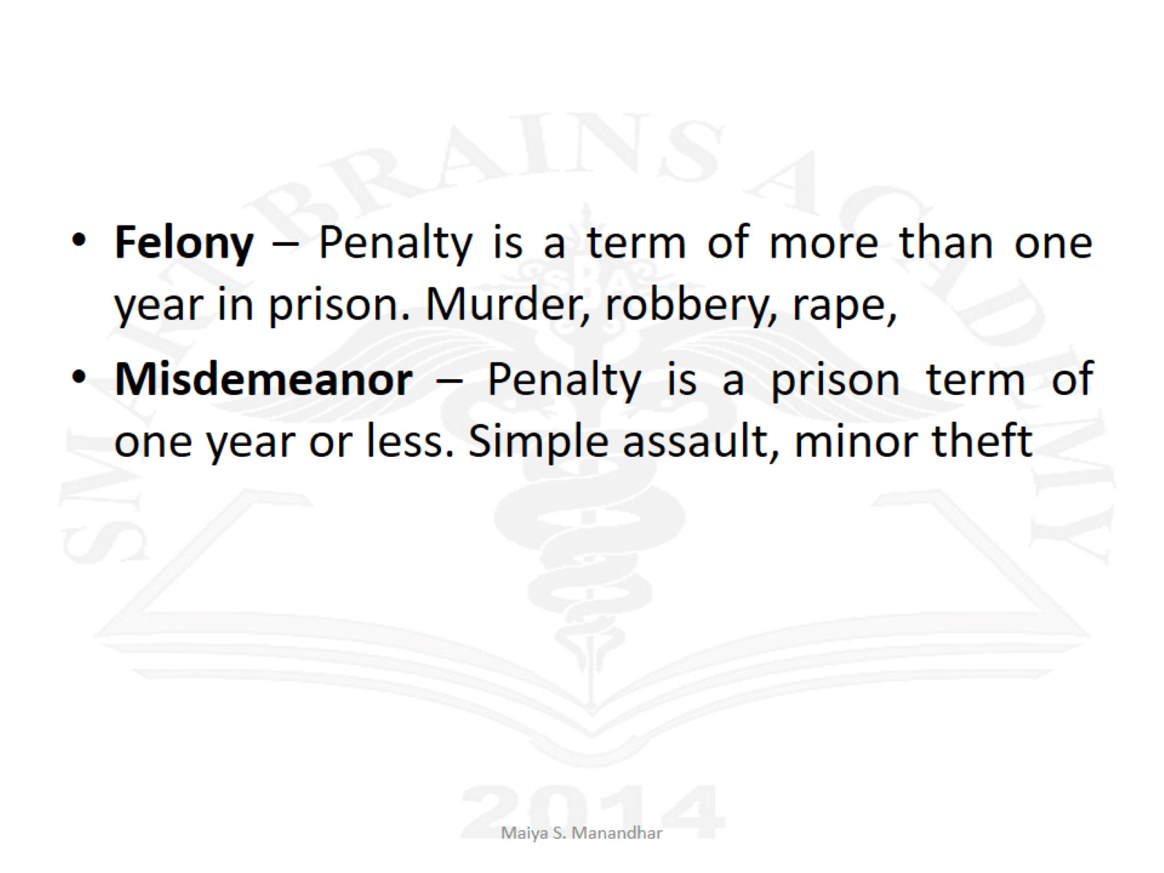

Slide 68
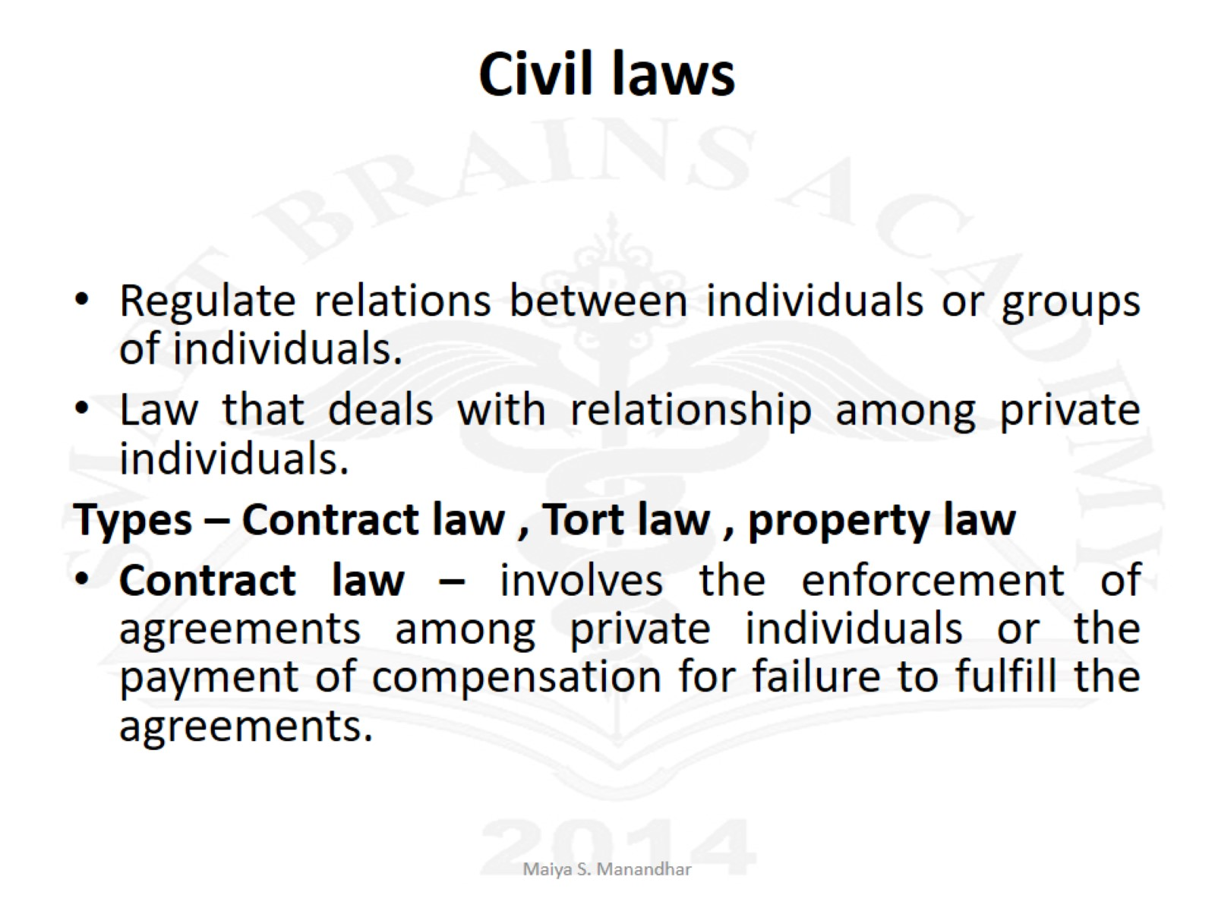
Civil laws

Slide 69
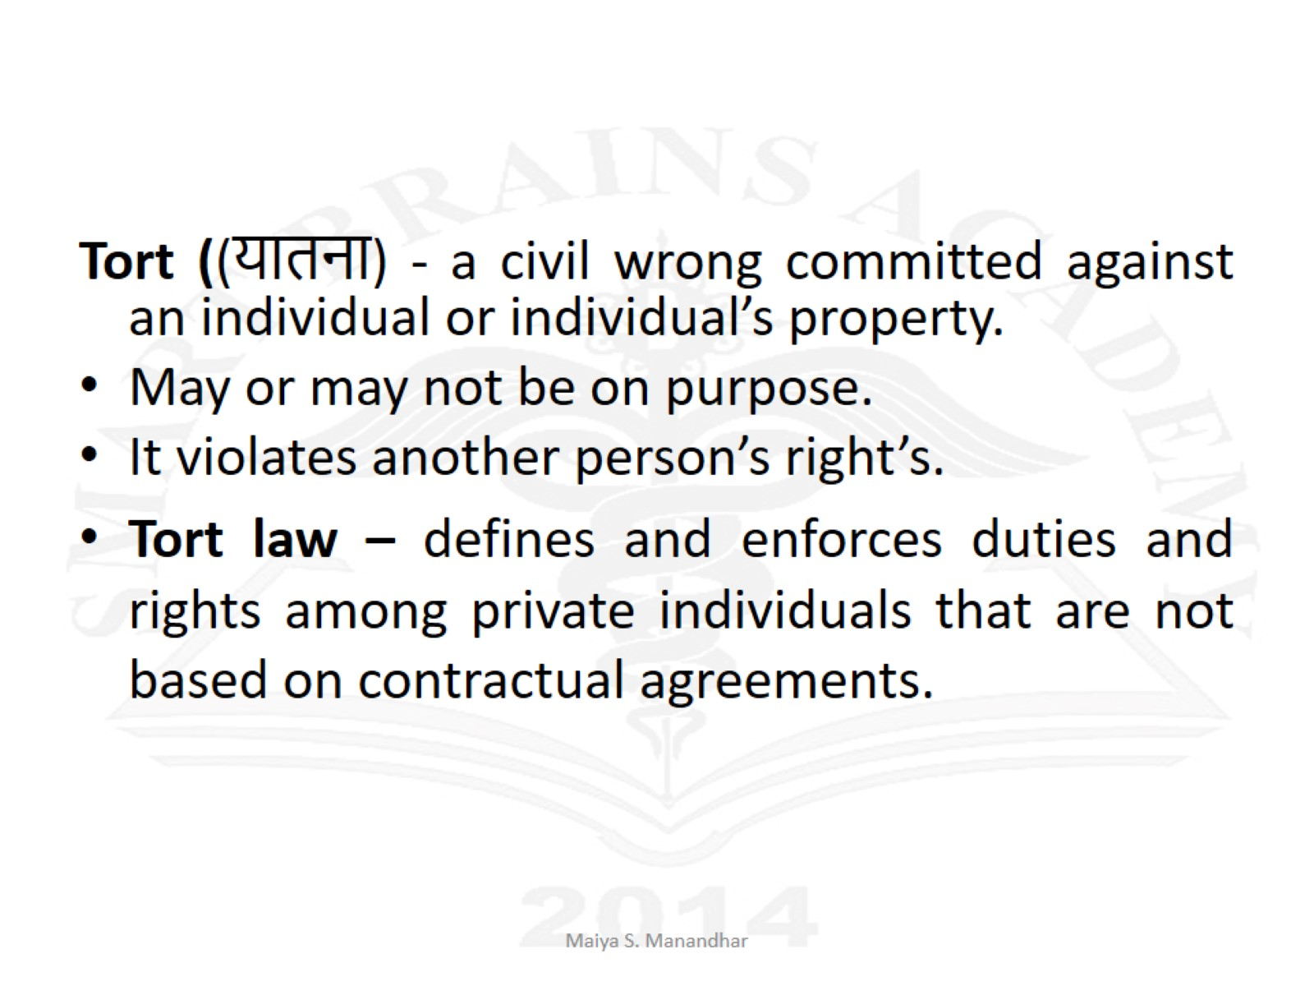

Slide 70
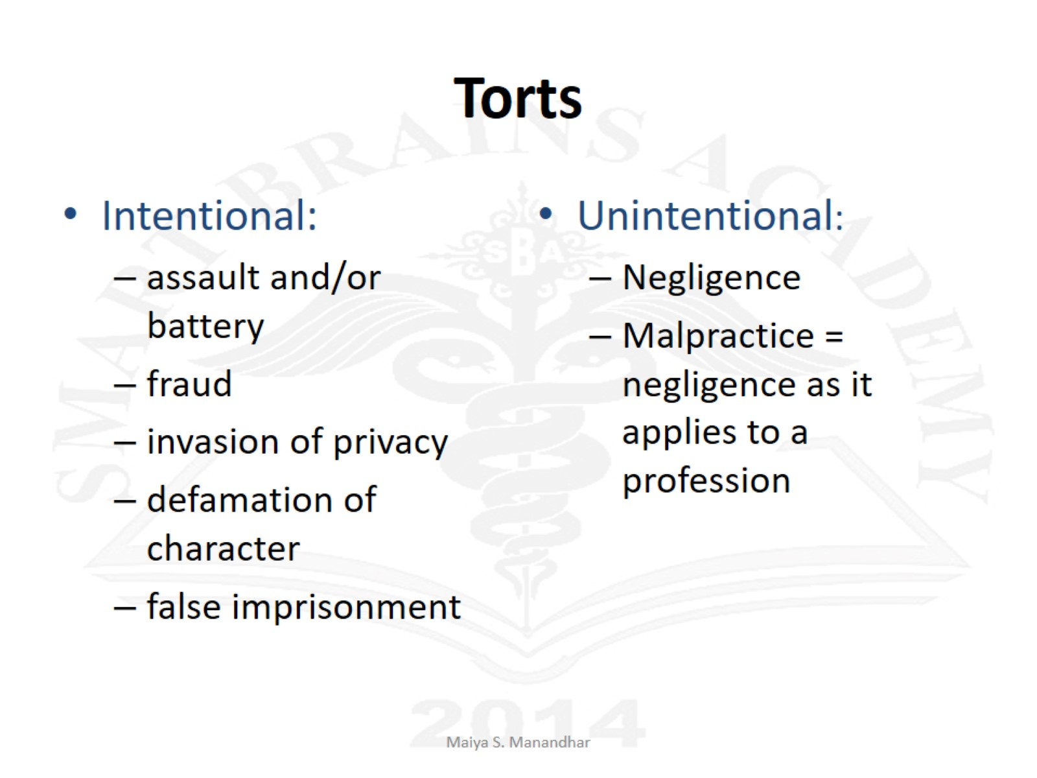
Torts

Slide 71

Assault
occurs when one person intentionally puts another in reasonable fear of an offensive or harmful bodily contact

Slide 72

Battery
Harmful or offensive touching, includes pushing,
punching, spitting, or shooting.

Slide 73
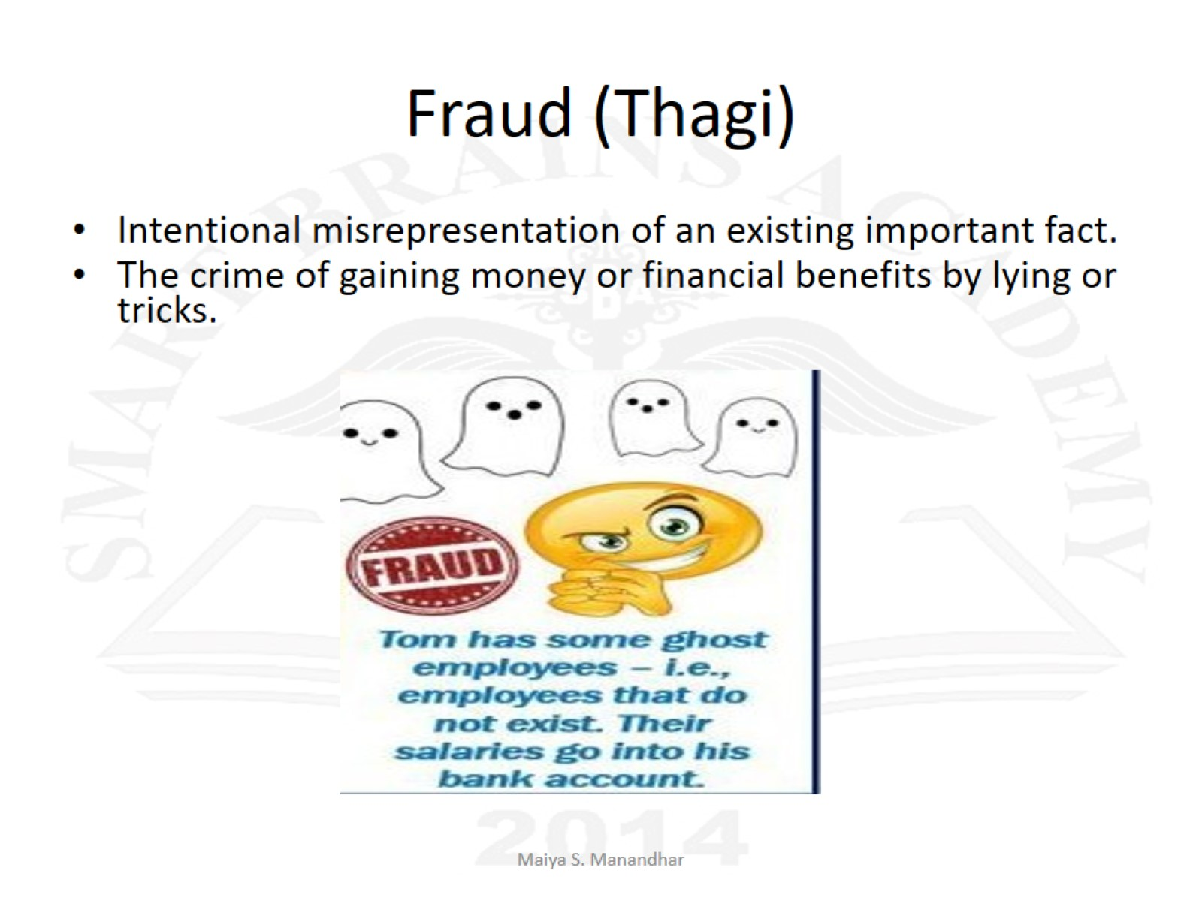
Fraud (Thagi)

Slide 74
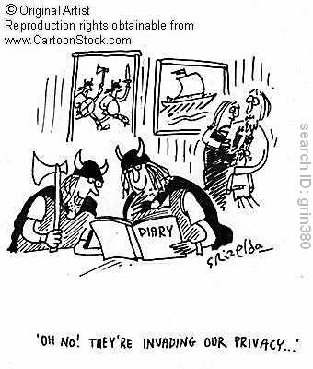
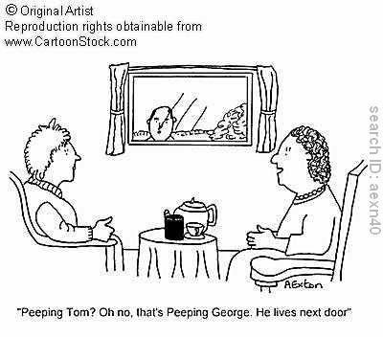
Invasion of Privacy
Uninvited intrusion into an individual’s personal
relationships and activities.

Slide 75

Defamation
False statements that injure a person’s reputation or good name.
slander—spoken defamation
libel- written or printed defamation
To be defamatory the statement must be:
False
Communicated to a 3rd party
The victim’s reputation is ruined or he/she faces ridicule

Slide 76

False Imprisonment
The intentional confinement of a person against the person’s will and without lawful privilege.
It can include being handcuffed or locked in a room or car.

Slide 77


Trespass to Land
Entry onto the property of another without the owner’s consent.

Slide 78
Unintentional
Negligence – misconduct or practice that is below the standard expected.
When a person owes a duty to another and, through failure to fulfill that duty, causes harm. Both nonmedical and professional persons can be liable for negligent acts.

Slide 79
Malpractice - is a type of negligence; it is often called "professional negligence". It occurs when a licensed professional (like a doctor, lawyer or accountant) fails to provide services as per the standards set by the governing body ("standard of care"), subsequently causing harm.

Slide 80
For a court to recognize a claim of negligence or malpractice, following legal elements must be present
Duty - There must be a duty owed to the client by nurse
The nurse must breach the duty – there must be a standard of care that is expected in the specific situation but that the nurse did not observe. For example – something was done that should not have been done or nothing was done when it should have been done.
Forseeability – A link must exist between the nurse’s act and the injury suffered.
Causation – It must proved that the harm occurred as a direct result of the nurse’s failure to follow the standard of care.
Harm or injury – There must be the some type of injury.

Slide 81
Common acts of negligence
Burns
Objects left inside the patiet’s body
Falls of elderly
Falls of children
Failure to observe and take appropriate action as needed.
Wrong medicine, route, dose
Failure to report

Slide 82
Common Malpractice Allegations
Failure to maintain safety
Improper technique/treatment
Failure to monitor and report
Medication errors
Failure to follow policy/procedures
Poor documentation
Improper use of equipment

Slide 83
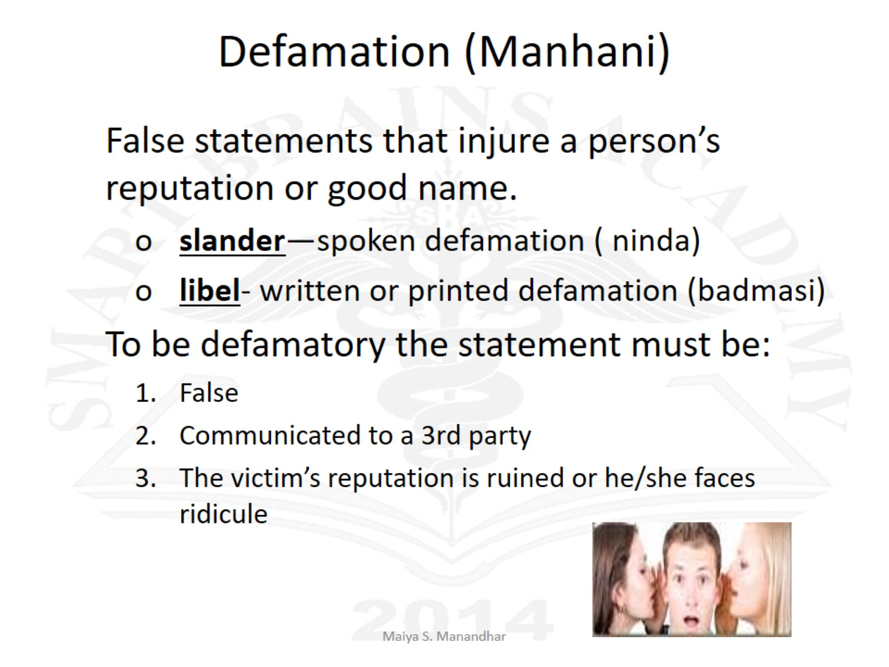
Defamation (Manhani)

Slide 84
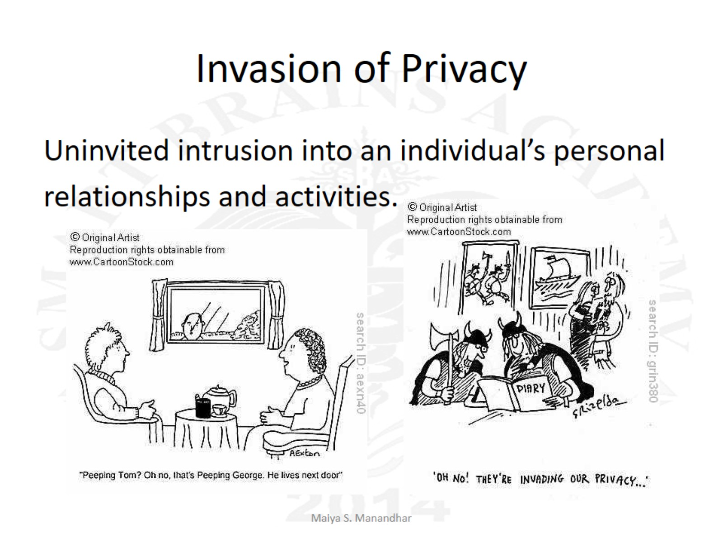
Invasion of Privacy

Slide 85

Trespass to Land

Slide 86
Fraud (Thagi)

Slide 87
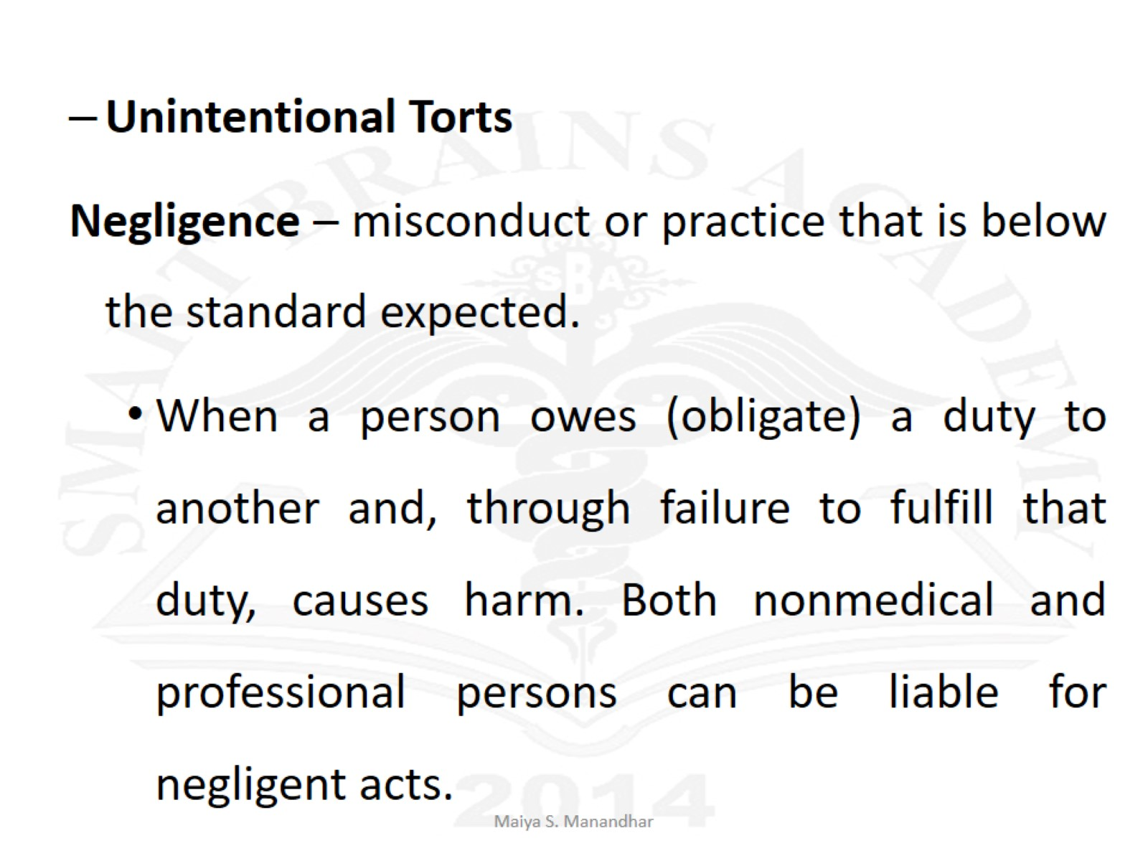

Slide 88
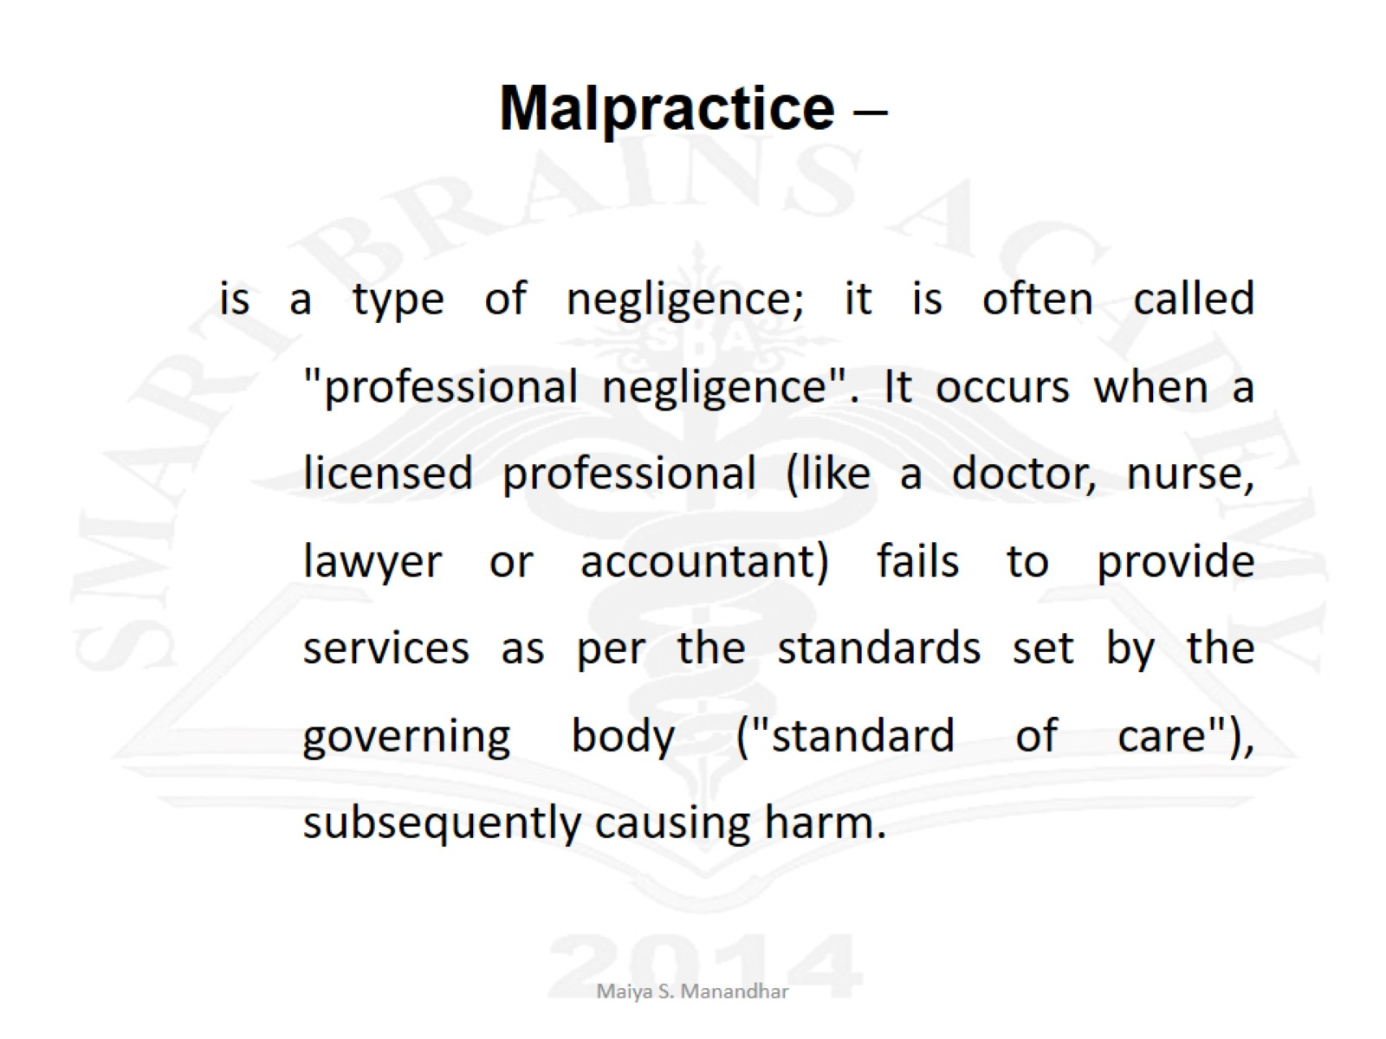
Malpractice –

Slide 89
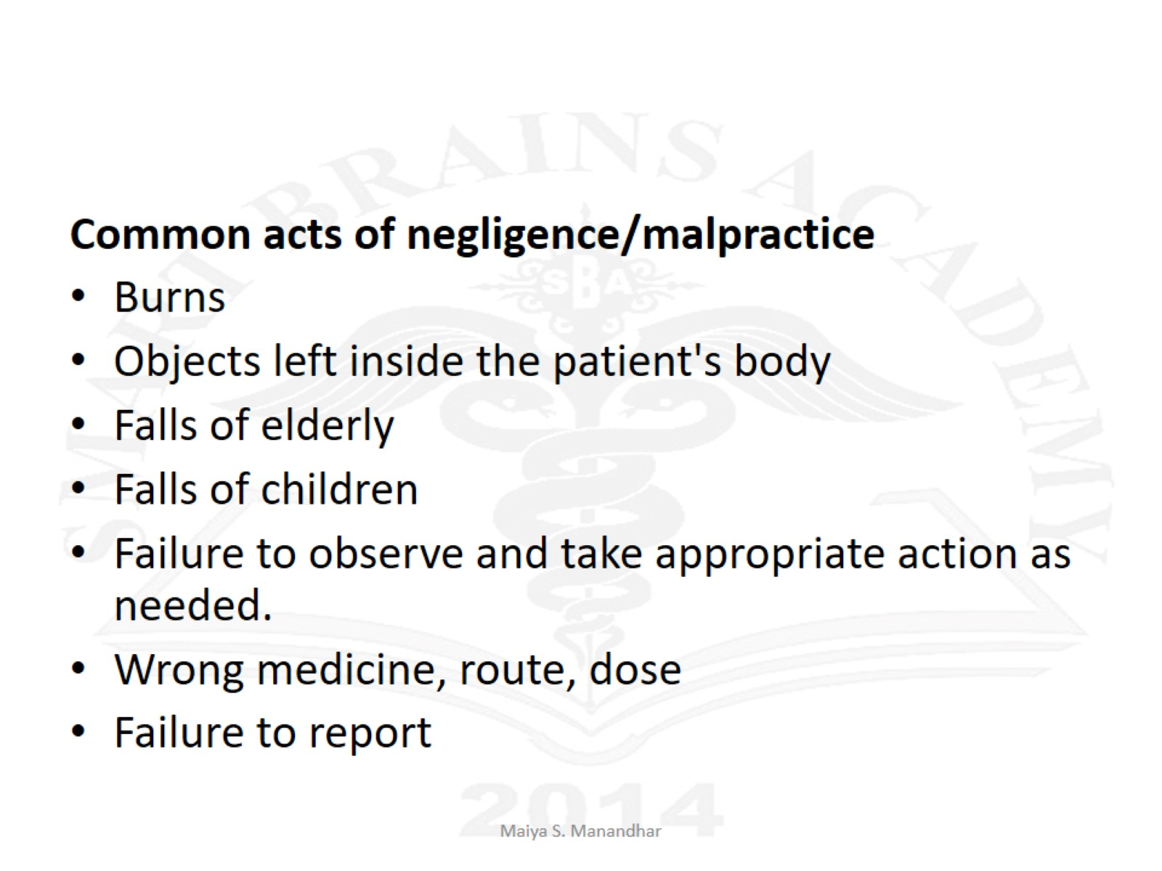

Slide 90
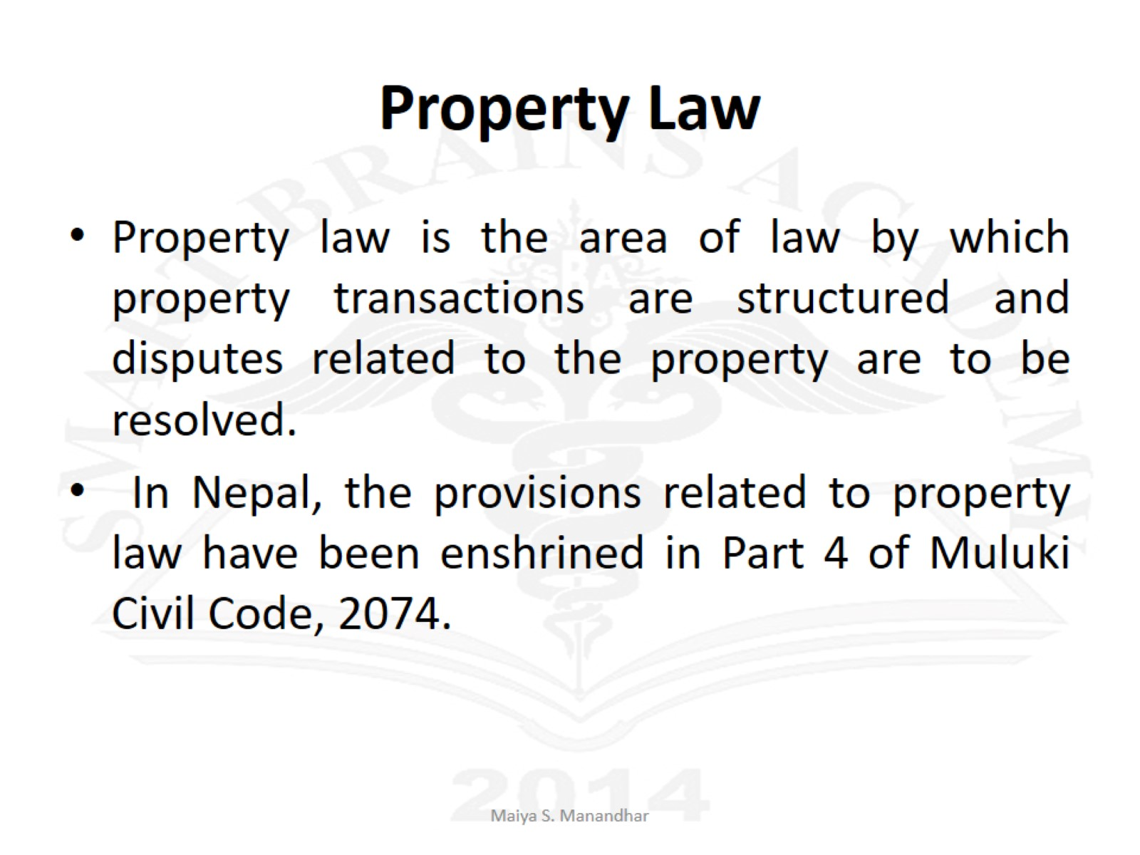
Property Law

Slide 93
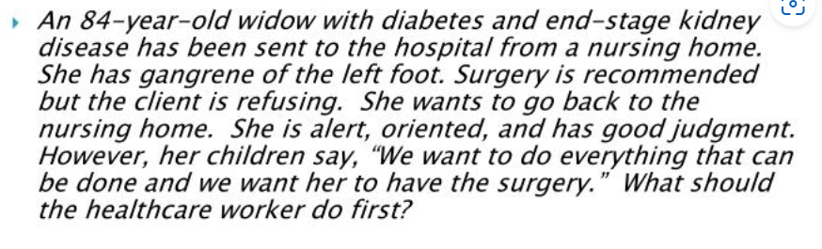

Slide 94
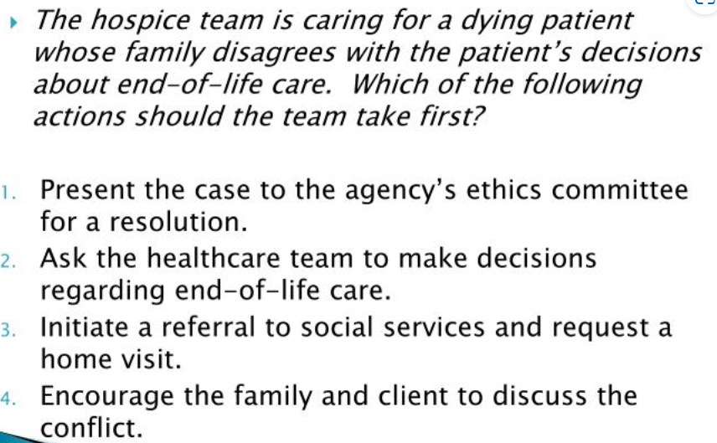

Slide 95
